Slide 1
Name:- suryavnshi shivam seat no-1406 guide name:Mahanoor man
R.K. DESAI ACHCHHARIWALA COLLEGE OF COMPUTER & APPLIED SCIENCES, VAPI

Slide 2

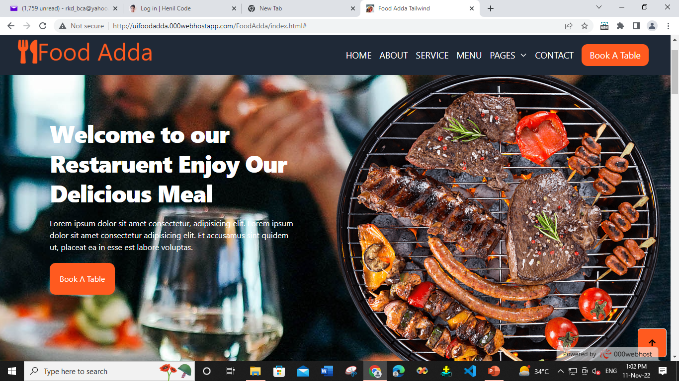
Food aDDA
Website:- http://uifoodadda.000webhostapp.com/FoodAdda/index.html

Slide 3
Front-end : HTML, CSS, JavaScript , jQuery , tailwind Back-end : PHP , MYSQL Editor : Visual Studio Code Icons : Bootstrap , fontawsome
Required Software for our Website

Slide 4
Index
Serial no : | Topics : | Page no :
1 | Collage Name ,Guide Name , Sit No, Name | 1
2 | Web Site Title , Web Site Link, Web Address Scanner have | 2
3 | Required Software for our Website | 3
4 | Introduction Of Our Website | 5
5 | Objective | 6
6 |  | 7
7 |  | 8

Slide 5
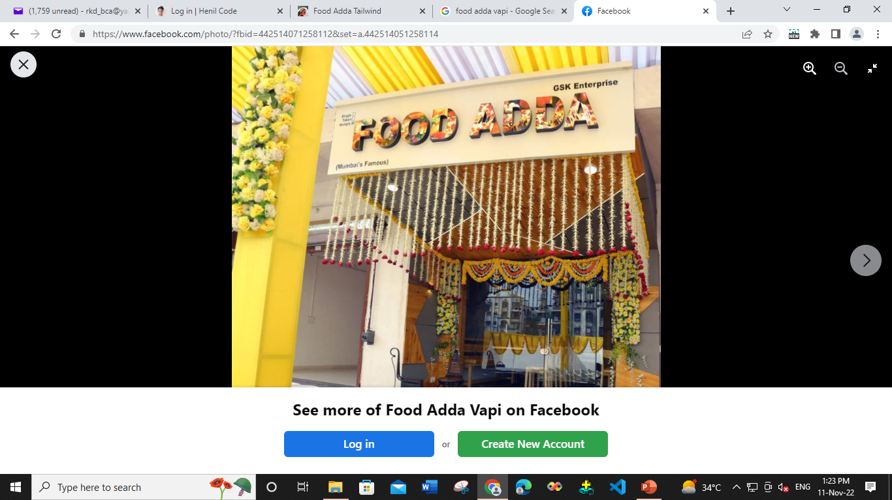
Order Food Online from Food Adda City Gidc and see it's menu for Home Delivery in Vapi. Fastest delivery | No minimum order | GPS tracking.
Introduction

Slide 6
Objective
s.no: | Advantages of Website
1 | Order 24/7
2 | User Friendly
3 | Web site use any OS
4 | Multi user use web site at one time
5 | After book table received email on user mail id with order details
6 | Web site show any device Mobile , Laptop , Desktop etc Its Responsive website
7 | Cancel order facility , support our customer on call

Slide 7


